Slide 1

WELCOME

Slide 2
Office of Parent and Family Relations
Parents and other family members play a critical role in student success
Primary point of contact for parents and families
Provides resources and programs
Enables understanding of University policies and procedures
Bridge between families and institution

Slide 3
Parents and Family Members Matter
Students are in contact with family members at least 10-14 times a week on average (Hofer and Moore, 2010, pg. 20)
Nearly 50% of families talk to their student daily (CampusESP 2024)
According to research, when parents are engaged and involved, student persistence increases by up to 15% and retention is 8% higher
75% of students frequently follow advise from a parent or guardian (Sax and Wartman, 2010, pg. 243)

Slide 4
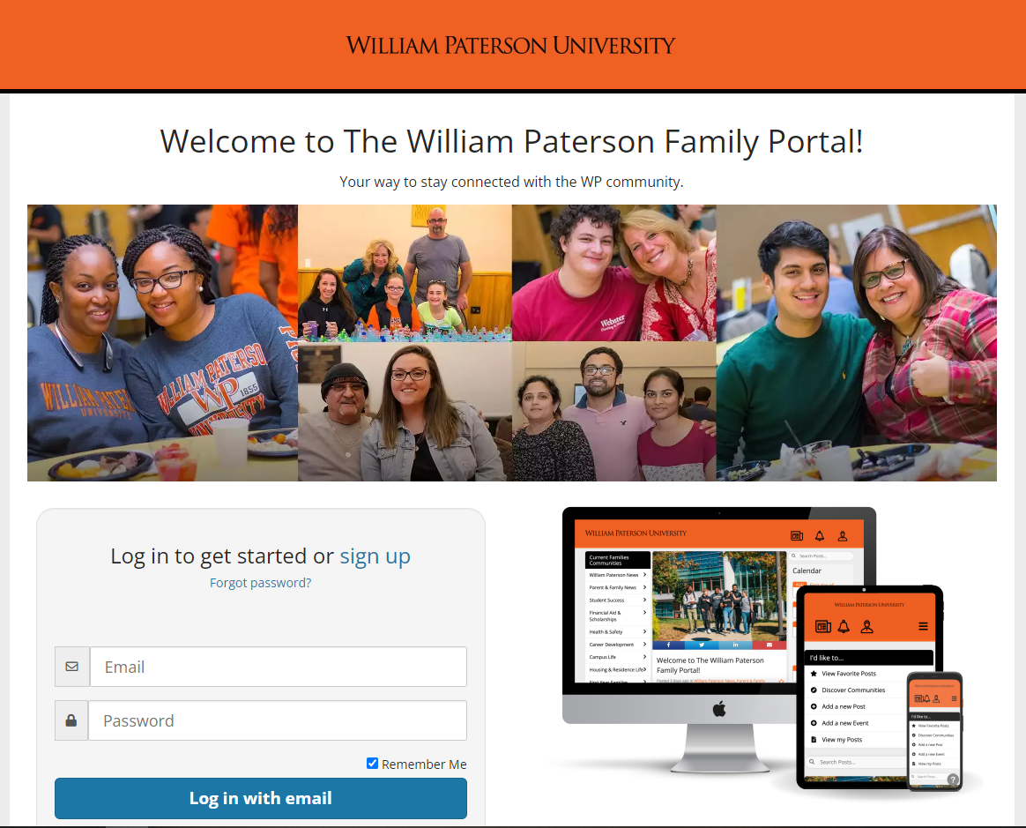

The William Paterson Family Portal
Important information and news
Upcoming deadlines and events
Resources
Newsletter
To get started:
wp.campusesp.com

Slide 5
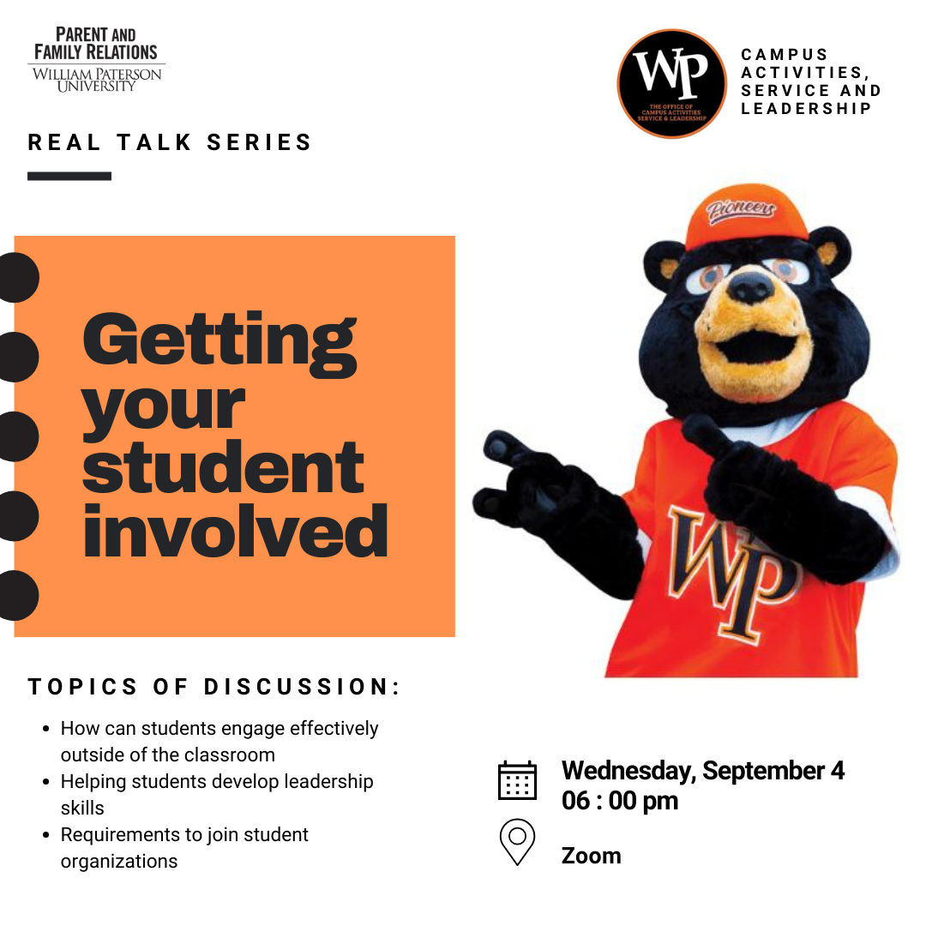
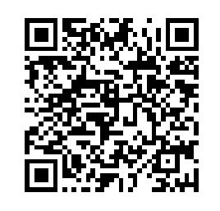
Real Talk Series
Monthly Virtual Gathering/Webinar
Key Topics of Interest
Connect with one another and University community
Creates a supportive environment for parents and families to ensure student success
Ask Questions
Scan QRC for additional information and webinar dates

Slide 6

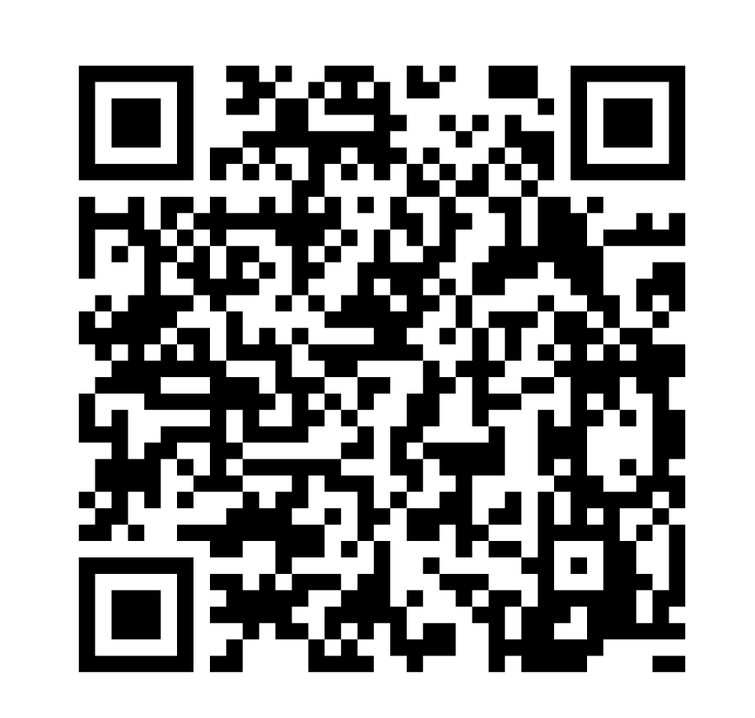
Scan QRC for More Information
Homecoming and Family Day
Saturday, November 9, 2024

Slide 7



Contact Us
Eva G. Reyes, MA
Director, Parent and Family Relations
University Commons Suite 117
reyese11@wpunj.edu
wpfamilies@wpunj.edu
973-720-2312
@wpunjfamilies

